Slide 1
Automated Email & Attachment Processing Using AI

Slide 2
Introduction
Problem Statement: Manual email classification and data extraction are time-consuming.
Solution: AI-powered automation to extract, analyze, and classify emails and attachments.

Slide 3
Key Features
✅ Extract text from email bodies, PDFs, images, and text files. ✅ Analyze structured data like transaction IDs, dates, and financial details. ✅ Classify emails using Google Gemini AI for smart categorization. ✅ Process inline images via OCR to capture critical details. ✅ Enhance accuracy with regex-based keyword extraction.

Slide 4
How It Works
📩 Step 1: User uploads an email with attachments. 🔍 Step 2: AI extracts text, applies OCR, and preprocesses data. 🤖 Step 3: Google Gemini API classifies the email into relevant categories. 📊 Step 4: Keywords and classification results are displayed on the UI.

Slide 5
Benefits
🚀 Faster Processing – No more manual effort! 🎯 Accurate Classification – AI-powered insights. 📂 Supports Multiple Formats – PDF, TXT, Images, Emails. 🔄 Scalable & Efficient – Handles large volumes effortlessly.

Slide 6
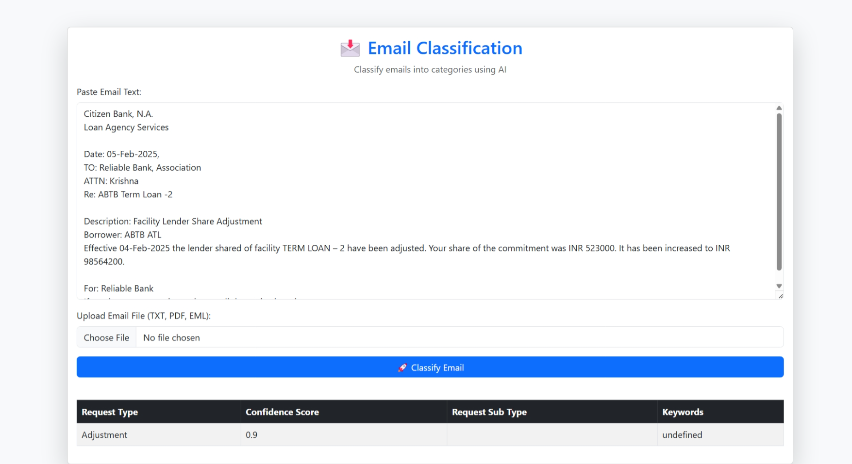
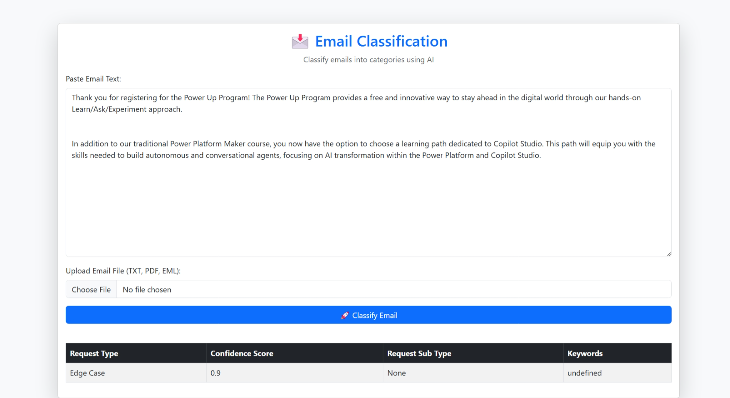
DEMO

Slide 7
Thank You

